Slide 1
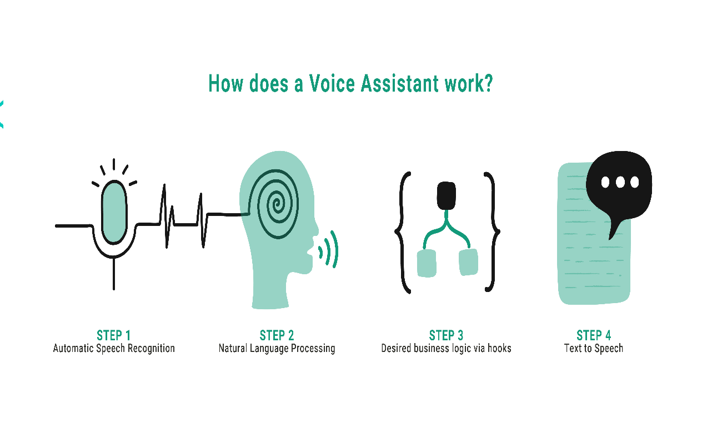

Introducing ChatGPT Voice Module-VoiceGenius
Our new voice module is designed to enhance user experience and improve customer service. Say goodbye to typing and hello to easy communication!
Atharva Gadekar
Tejas Sinkar
Guide: Dr. Ritambhra Korpal

Slide 2
Benefits of ChatGPT Voice Module
1 2
Improved Customer Satisfaction
By providing a personalized interaction, customers feel valued and heard, leading to increased satisfaction and loyalty.
3
Cutting-Edge Technology
Our module uses state- of-the-art algorithms to recognize and accurately interpret voice commands, providing a seamless experience for the user.
Increased Efficiency
The voice module enables faster and more accurate communication, reducing response time and enhancing productivity.

Slide 3
Technical Specifications
Voice Recognition
Integration
Security
Uses natural language processing to identify spoken commands and intents.
Compatible with popular platforms such as Amazon Alexa and Google Assistant.
Uses end-to-end encryption to ensure privacy and confidentiality.

Slide 4

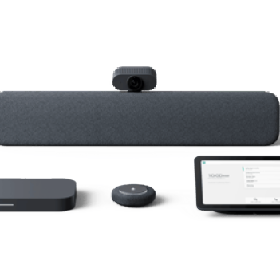
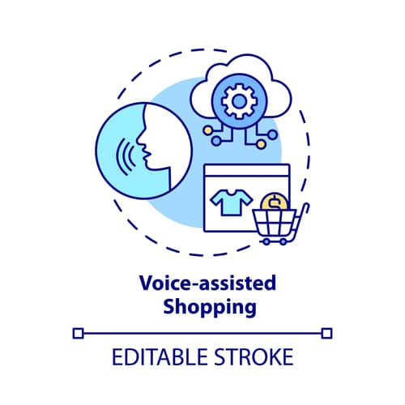
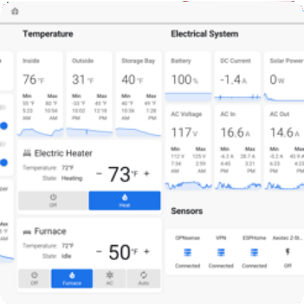
Use Cases & E amples
Meeting Room Assistant
Use the ChatGPT Voice Module to take notes, schedule meetings, and make phone calls with ease.
Voice-Assisted Shopping
Using ChatGPT, your customers can order products, track orders, and get instant customer support, all with their voice.
Home Automation Assistant
Control temperature, lighting, music, and more using simple voice commands. ChatGPT makes home automation easy and intuitive.

Slide 5
Advantages of VoiceGenius
Accessibility: TTS technology enables visually impaired individuals or those with reading difficulties to access written information by converting it into spoken words.
Multilingual Support: TTS systems can be developed to support multiple languages, allowing users to listen to content in their preferred language.
Natural Sounding Speech: Advanced TTS systems leverage machine learning techniques to generate more natural and human-like speech, improving the overall user experience.
Disadvantages of VoiceGenius
Lack of Emotional Variation: While TTS systems have improved in generating natural speech, they often struggle to convey emotions effectively, as they lack the subtle nuances and variations in tone that humans naturally express.
Pronunciation and Accent Challenges: TTS systems may encounter difficulties in accurately pronouncing certain words or names, especially those from different languages or with uncommon phonetic patterns.
Robotic Sounding Speech: Although TTS systems have made significant progress in sounding more natural, certain instances may still result in speech that sounds artificial or robotic, which can impact the user experience.

Slide 6
Code Structure:
Importing necessary libraries:
OpenAI for AI-generated response
Pyttsx3 for text to speech conversion
speechRecognition for speech recognition
Webbrowser for opening web browsers
Googletrans for translation
Sys for system for functions
Setting up API key and creating instances:
Set openAI API key
Create an instance of the openAI completion class
Initialize pyttsx3 engine for text-to-speech conversion
Create an instance of the Translator class
Defining functions:
Generates AI response based on the user’s question.
Speak(text) It converts text to audible speech using pyttsx
Translate_text(text, target_response)

Slide 7
Pricing & Licensing Options
Basic License
Free version with limited features and usage.
Standard License
Licensed per user with support and full features.
Enterprise License
Customizable licensing options for larger organizations.

Slide 8

Conclusion & Q&A
The ChatGPT Voice Module provides a simple and natural way for users to interact with technology. It can help businesses increase productivity, improve customer satisfaction, and streamline communication. Contact us for a demo and get started with ChatGPT today!

